Slide 1
APPLICATION DEVELOPMENT USING REACT JS AND SPRING BOOT
Preapred by & Owned by Karan Dharmlingam
PRANESH S

Slide 2

TECH STACK
FRONTEND
MIDDLEWARE
BACKEND
UI/UX
Business Logic
DB
Middleware is software that acts as an intermediary, enabling different applications and systems to communicate and interact efficiently by handling tasks like authentication, logging, and data management.
The backend is the part of a software system or application that handles the server-side logic, database interactions, and application functionality that users don't see. It includes the server, database, and application code that processes user requests, performs operations, and sends responses to the front end.
Front-end web development involves creating a website's graphical user interface using HTML, CSS, and JavaScript, enabling users to view and interact with the site.

Slide 3
TECH STACK
REACT
JAVA
MYSQL
CRA template
Springboot
MySQL - Workbench
Create React App provides a straightforward and reliable setup, while Vite offers a highly performant and flexible development experience. Whichever you choose, you're bound to have a solid foundation for your React. js project.
Spring Boot Extension is Spring's convention-over-configuration solution intended to aid in creating production-grade Spring applications with minimal amounts of configuration.
MySQL Workbench is a visual database management tool that aids in designing, developing, and administering MySQL databases, offering features like modeling, SQL development, and server administration.

Slide 4
WHY DO WE NEED FULL STACK DEVELOPMENT?
Full stack development involves working on both the front-end and back-end portions of an application. This comprehensive approach is essential for several reasons:
Seamless User Experience:
Consistency: Full stack development ensures a consistent user experience by integrating front-end and back-end components seamlessly.
Efficiency: Developers can optimize the performance of the application by understanding the complete workflow and making informed decisions.
Improved Collaboration and Communication:
Unified Team: A full stack developer understands both sides of the application, facilitating better communication between front-end and back-end teams.
Reduced Dependencies: With a full stack approach, there's less need for back-and-forth between separate front-end and back-end teams, which can streamline the development process.

Slide 5
WHY DO WE NEED FULL STACK DEVELOPMENT?
Faster Development and Deployment:
Single Developer or Small Team: A full stack developer or a small team can handle the entire development process, leading to faster prototyping and iteration.
Holistic Problem Solving: Full stack developers can diagnose and solve problems that span the entire stack, speeding up the troubleshooting process.
Versatility and Flexibility:
Adaptability: Full stack developers can switch between front-end and back-end tasks as needed, providing flexibility in the development process.
Wide Range of Skills: This versatility can be particularly beneficial for startups and smaller companies where resources may be limited.

Slide 6
WHY DO WE NEED FULL STACK DEVELOPMENT?
Cost-Effectiveness:
Reduced Hiring Costs: Hiring full stack developers can be more cost-effective than hiring separate front-end and back-end developers.
Lower Maintenance Costs: A unified approach can lead to lower maintenance costs since the same developer(s) can handle updates and bug fixes across the entire application.
Better Understanding of the Application:
End-to-End Knowledge: Full stack developers have a comprehensive understanding of how the application works, which can lead to better design and more efficient code.
User-Centric Development: This understanding allows for the development of more user-centric features, as developers can see the application from both a user and technical perspective.

Slide 7
UML DIAGRAMS
Terminal
Unified Modeling Language (UML) diagrams are a standard way to visualize the design of a system. They help understand, document, and communicate a system's structure and behavior.

Slide 8
CLASS DIAGRAM
Purpose: Shows the static structure of a system, including classes, their attributes, methods, and relationships.
Components:
Classes: Represented as rectangles divided into three parts: the class name, attributes, and methods.
Relationships: Associations (lines), inheritance (arrows with empty triangles), aggregation (diamonds), and composition (filled diamonds).

Slide 9
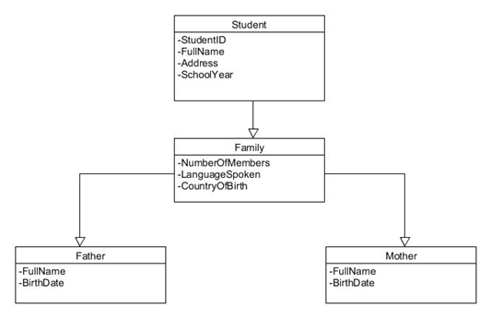
CLASS DIAGRAM

Slide 10
USE CASE DIAGRAM
Purpose: Illustrates the functionality of a system from a user's perspective, showing interactions between users (actors) and use cases (system functions).
Components:
Actors: Stick figures representing users or external systems.
Use Cases: Ovals representing functions or services.
Relationships: Lines connecting actors to use cases, with possible extensions or inclusions.

Slide 11
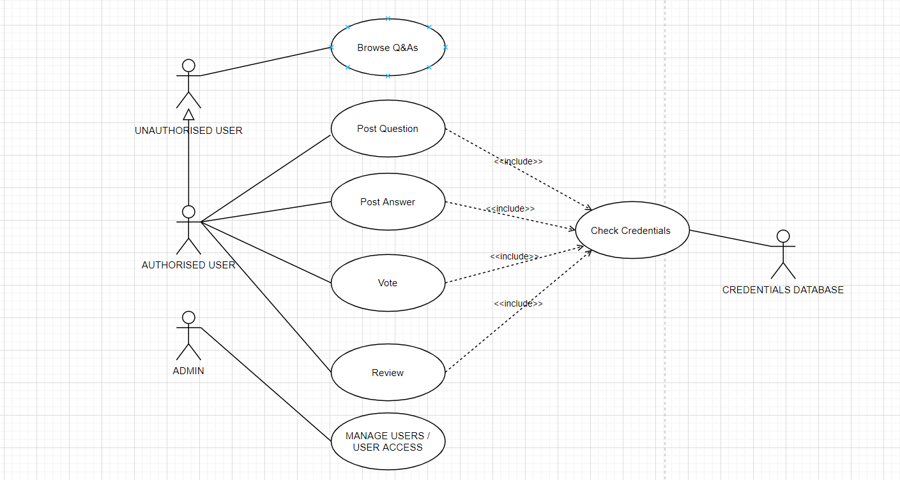
USE CASE DIAGRAM

Slide 12
SEQUENCE DIAGRAM
Purpose: Shows how objects interact in a particular sequence to achieve a specific outcome.
Components:
Objects: Represented as rectangles at the top.
Lifelines: Dashed lines extending down from objects.
Messages: Arrows showing communication between objects, annotated with message names.

Slide 13
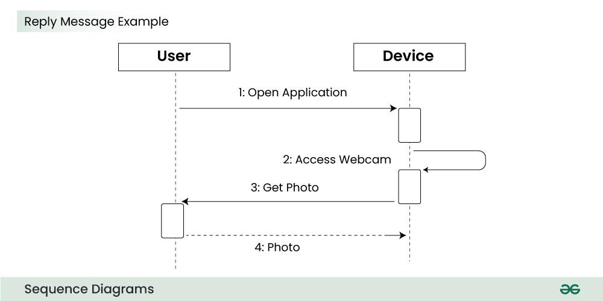
SEQUENCE DIAGRAM

Slide 14
ACTIVITY DIAGRAM
Purpose: Describes the dynamic aspects of a system, particularly the flow of activities or operations.
Components:
Activities: Rounded rectangles representing actions.
Flows: Arrows showing the direction of flow.
Decision Points: Diamonds representing branching points.
Start/End Points: Filled circles (start) and filled circles with borders (end).

Slide 15
ACTIVITY DIAGRAM

Slide 16
ACTIVITY DIAGRAM

Slide 17
DBMS DATA MODELS
Defines the logical design and structure of a database
•Hierarchical Model
•Network Model
•Entity-relationship Model
•Relational Model
•Defines how data will be stored, accessed, and updated in a database management system.
• The Relational Model is the most widely used database model.

Slide 18
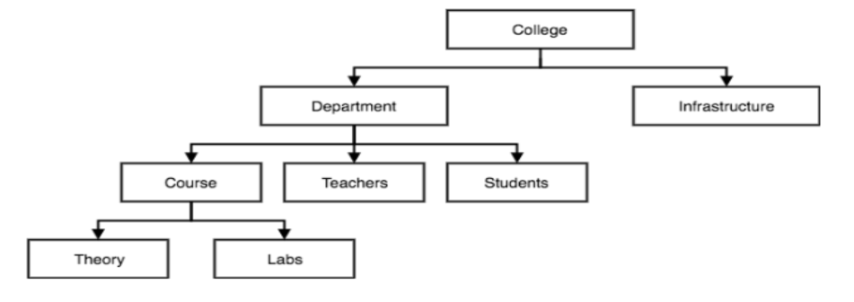
HIERARCHICAL MODEL
•It organizes data into a tree-like structure.
•A child node will only have a single parent node.
• E.g.. one department can have many courses, many professors and of-course many students.

Slide 19
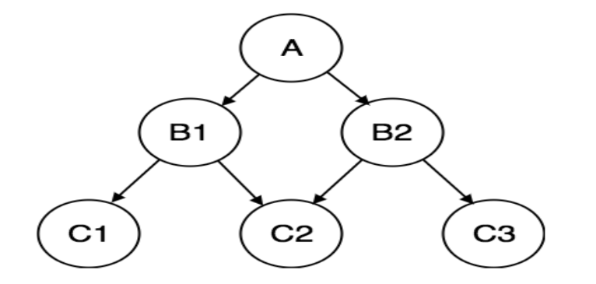
NETWORK MODEL
It is an extension of the Hierarchical model.
•Data is organized more like a graph.
•This model can have more than one parent node.
•This was the most widely used database model, before Relational Model

Slide 20
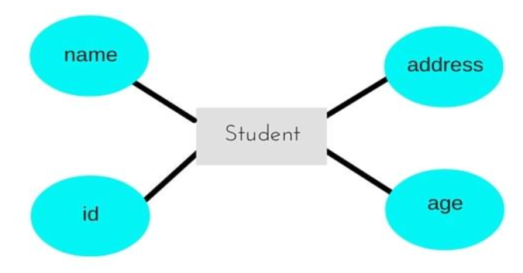
ENTITY-RELATIONSHIP MODEL
•It represents the relationships in pictorial form to make it easier.
•Relationships are created by dividing the object of interest into entities and its characteristics into attributes.
•Different entities are related using relationships.
•This model is good for designing a database.

Slide 21
ER DIAGRAM
The ER(Entity Relational Model) is a high-level conceptual data model diagram.
•Entity-Relation model is based on the notion of real-world entities and the relationship between them.
•ER modeling helps you to analyze data requirements systematically to produce a well-designed database.
•ER diagrams can be used by database designers as a blueprint for implementing data in specific software applications.
•Entity-Relation model is based on the notion of real-world entities and the relationship between them.
•ER modeling helps you to analyze data requirements systematically to produce a well-designed database.
ER Modeling is a Top-Down approach
You can only use 64 characters in a DB Name,

Slide 22
COMPONENTS OF ER-DIAGRAM
Entities
An entity is a real-world object that is represented in the database. It can be any object, place, person, or class. Data are stored about such entities. An entity can be represented by a rectangle shape.
Example: Person, Place, Event, Car, etc.
Attributes
Attributes are the properties that define the entity type.
For example, Roll_No, Name, DOB, Age, Address, and Mobile_No are the attributes that define entity type Student. In the ER diagram, the attribute is represented by an oval.
Relationships
A relationship is nothing but an association among two or more entities. Diamonds symbol represents relationship types. E.g.: Tom works in the Chemistry department

Slide 23
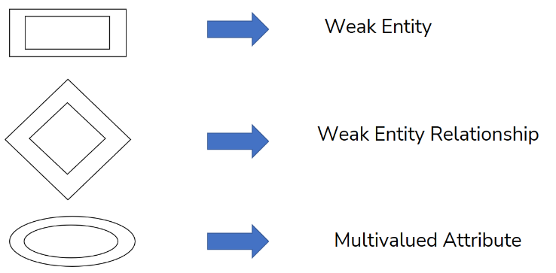
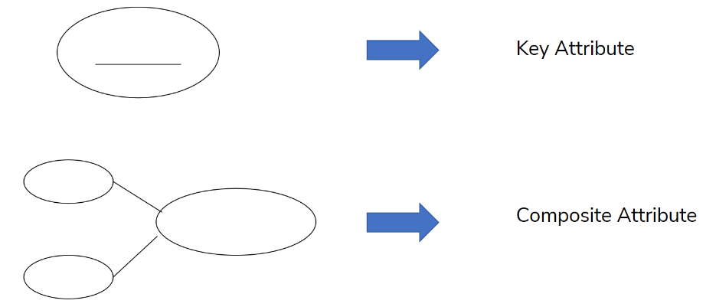
ER DIAGRAM SYMBOLS AND NOTATION

Slide 24
RELATIONAL MODEL
Relational Databases store data in relations.
•The data is stored in the form of tables.
•An attribute is a named column of a relation.
•It stores specific information about an object. E.g. salary
Specialization
Generalization
Categorization
An ER diagram has support for generalization/specialization modeling. Generalization and Specialization are the same relationship, with a different direction of classification. Generalization is bottom-up, while specialization is top-down.
Categories permit the grouping of entities from different entity types according to the roles they play in a relationship, as well as the representation of ISA and generalization hierarchies.

Slide 25
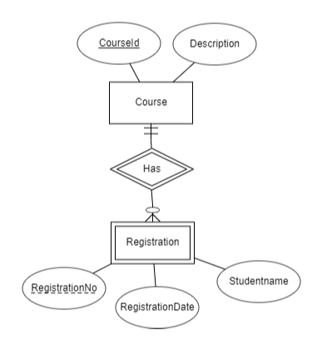
WEAK ENTITY
An entity that cannot be uniquely identified by its own attributes and relies on the relationship with other entity is called weak entity. The weak entity is represented by a double rectangle.
Every weak entity must be associated with an identifying entity; that is, the weak entity set is said to be existence dependent on the identifying entity set. The identifying entity set is said to own the weak entity set that it identifies. It is also called as owner entity set.

Slide 26
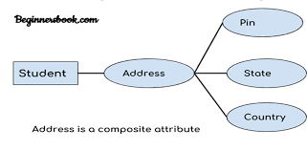
MULTIVALUED ATTRIBUTE
An attribute that can hold multiple values is known as a multivalued attribute. It is represented with double ovals in an ER Diagram. For example – A person can have multiple phone numbers, so the number attribute is multivalued.

Slide 27
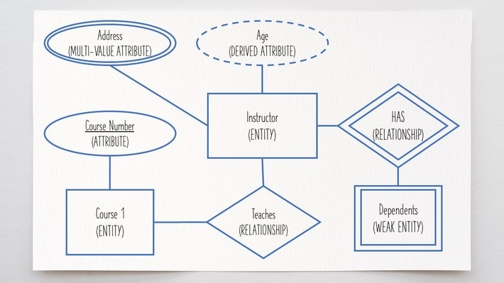
KEY ATTRIBUTE
A key attribute can uniquely identify an entity from an entity set. For example, student roll numbers can uniquely identify a student from a set of students. Key attribute is represented by oval same as other attributes however the text of key attribute is underlined.

Slide 28
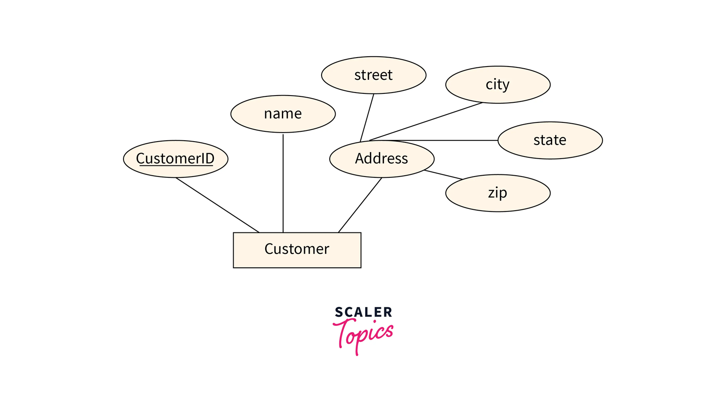
COMPOSITE ATTRIBUTE
An attribute that combines other attributes is known as a composite attribute. For example, In a student entity, the student address is a composite attribute as an address is composed of other attributes such as pin code, state, and country.

Slide 29
TABLES AND RECORDS
Tables - Entities
Columns - Fields
Rows - Records, Tuples,
Descriptions - Attributes
entity has its relationship to another entity determined by an attribute in that other entity - Subtype entity
A weak entity set in an E-R diagram is an entity set that - must be part of a one-to-many relationship set
a relationship between two entities of similar entity type is called a - Recursive

Slide 30
REACT JS
Terminal
React is a free and open-source front-end JavaScript library for building user interfaces based on components by Facebook Inc. It is maintained by Meta and a community of individual developers and companies. React can be used to develop single-page, mobile, or server-rendered applications with frameworks like Next.js

Slide 31
REACT JS
Class Components
Functional Components
Class components in React use ES6 classes, allowing for state management and lifecycle methods to handle complex logic and side effects within a component.
Functional components are stateless JavaScript functions that accept props and return React elements, with hooks available for managing state and side effects.

Slide 32
REACT JS VIRTUAL DOM
The Virtual DOM in React is an in-memory representation of the real DOM elements generated by React components. React uses this virtual DOM to optimize updates to the actual DOM, improving performance.

Slide 33
PROPS
Props are a type of object where the value of attributes of a tag is stored.
The word “props” implies “properties”, and its working functionality is quite similar to HTML attributes.
Props components are read-only components.

Slide 34
USE EFFECT
useEffect is a Hook in React that lets you perform side effects in function components. It combines the capabilities of lifecycle methods in class components, like componentDidMount, componentDidUpdate, and componentWillUnmount, into a single API.
Purpose
Side Effects: useEffect is designed to handle side effects such as fetching data, updating the DOM, and setting up subscriptions or timers.
Functional Component Lifecycle: It manages the lifecycle of functional components, running code at specific points during

Slide 35
USE STATE
useState is a fundamental hook in React that allows you to add state management to functional components. Before hooks were introduced, state management in React was only possible in class components. The useState hook enables functional components to have their own state, making functional components more powerful and versatile.

Slide 36
USECONTEXT
useContext is a hook in React that allows you to access the context value from within a functional component. It makes it easier to share data and state across the component tree without the need for prop drilling, which is passing props through multiple levels of components. This hook is particularly useful for global state management and theming.
When to Use useContext
Global State: Managing global state such as user authentication, theme, and settings.
Theming: Applying global themes and styles across the application.
Localization: Managing and providing localized strings and translations.

Slide 37
USEREF
useRef is a React hook that provides a way to persist mutable values across renders without causing re-renders. It is often used for accessing and interacting with DOM elements directly, but it also serves other purposes, such as storing mutable values that don't trigger a re-render when changed.
Key Points
Ref Object: useRef returns a mutable ref object. The current property of this object holds the value.
Persisting Values: The value of ref.current persists between renders. Changing ref.current does not trigger a re-render.
Initial Value: The initialValue argument is used to set the initial value of ref.current, but this value is only used on the initial render.

Slide 38
HOOKS RULES
Rules of Hooks
Only call hooks at the top level: Don’t call hooks inside loops, conditions, or nested functions.
Only call hooks from React functions: Call them from within React functional components or custom hooks.
Best Practices
Keep state minimal: Only store data that is necessary for rendering.
Use multiple state variables if needed: Instead of storing all data in a single object, you can use multiple useState calls for different pieces of state.
Functional updates: Use functional updates to avoid stale closures when the new state depends on the previous state.

Slide 39
BEST PRACTICES IN REACT
Component Design
Functional Components: Prefer functional components over class components. They are simpler, easier to read, and leverage hooks for state and lifecycle management.
Component Decomposition: Break down components into smaller, reusable pieces. Each component should ideally do one thing and do it well.
Presentational vs. Container Components: Separate presentational components (which focus on rendering UI) from container components (which handle logic and state).
Single Responsibility Principle: Each component should have a single responsibility. Avoid components that do too many things.

Slide 40
BEST PRACTICES IN REACT
State Management
Lift State Up: If multiple components need access to the same state, lift the state up to their nearest common ancestor.
Use Context Wisely: Use React Context for global state or theming, but avoid using it for frequently changing state due to performance concerns. For complex state management, consider tools like Redux or Zustand.
Hooks for State Management: Utilize useState, useReducer, and useContext for managing state in functional components.

Slide 41
BEST PRACTICES IN REACT
Code Organization
Folder Structure: Organize your files and folders logically, such as grouping by features or components. Common structures include components/, hooks/, and utils/.
Naming Conventions: Use clear and consistent naming conventions for components, hooks, and variables. Typically, components are named in PascalCase, while functions and variables use camelCase.
CSS in JS: Consider using CSS-in-JS libraries like styled-components or Emotion for scoped and modular styles, or CSS Modules for local scoping.

Slide 42
BEST PRACTICES IN REACT
Security
Avoid Inline Styles: To prevent security issues like Cross-Site Scripting (XSS), avoid using inline styles and always sanitize user input.
Use Secure APIs: Ensure that your application uses secure APIs and follows best practices for authentication and authorization.

Slide 43
BEST PRACTICES IN REACT
Documentation and Comments
Document Components: Provide clear documentation for your components, including their purpose, props, and usage.
Comment Wisely: Write comments to explain complex logic but avoid over-commenting. The code itself should be self-explanatory wherever possible.

Slide 44
BEST PRACTICES IN REACT
Version Control and Collaboration
Use Git Effectively: Commit changes with meaningful messages, use branches for features and bug fixes, and regularly merge changes.
Code Reviews: Participate in code reviews to ensure code quality and share knowledge within the team.

Slide 45
REACT REDUX
Terminal
Redux is a state management library for JavaScript applications, often used with React for predictable state management. It centralizes the application's state in a single store, allowing for easier state tracking and debugging. Redux uses actions, reducers, and a store to manage the state flow in a predictable manner.

Slide 46
REDUX
React Redux is the official UI binding for react Application. It is updated with API changes to ensure that your React components behave as expected.
It encourages good 'React' architecture.
It implements many performance optimizations internally, allowing components to re-render only when needed.

Slide 47
REDUX STATE MANAGEMENT
STATE
STORE: A Store is a place where the entire state of your application is listed. It manages the status of the application and has a dispatch(action) function. It is like a brain responsible for all moving parts in Redux.
ACTION: Action is sent or dispatched from the view which are payloads that can be read by Reducers. It is a pure object created to store the information of the user's event. It includes information such as type of action, time of occurrence, location of occurrence, its coordinates, and which state it aims to change.
REDUCER: Reducer reads the payloads from the actions and then updates the store via the state accordingly. It is a pure function to return a new state from the initial state.
contains
defines
STORE
UI
updates
triggers
REDUCER
ACTIONS
sent to

Slide 48
REDUX STORE
The Redux store is the central hub that holds the entire state of your application. It manages the state through the use of reducers and allows state changes to be tracked and handled in a predictable manner. The store serves three main purposes:
Holds the state: The store is the single source of truth for the application's state.
Dispatches actions: The store allows actions to be dispatched, which are then processed by reducers to update the state.
Registers listeners: The store allows components to subscribe to state changes, so they can react when the state updates.

Slide 49
REDUX STORE
To initialize a Redux store, follow these steps:
Install Redux and React-Redux: First, you need to install Redux and React-Redux using npm
npm install redux react-redux
Create Reducers: A reducer is a pure function that takes the previous state and an action, and returns the next state. You typically define multiple reducers for different parts of the state and combine them.
reducer.js
import { combineReducers } from 'redux';
const initialState = {
count: 0,
};
function counterReducer(state = initialState, action) {
switch (action.type) {
case 'INCREMENT':
return { ...state, count: state.count + 1 };
case 'DECREMENT':
return { ...state, count: state.count - 1 };
default:
return state;
}
}
const rootReducer = combineReducers({
counter: counterReducer,
// other reducers can go here
});
export default rootReducer;

Slide 50
REDUX STORE
store.js
3. Create the Store: You create the store by passing the root reducer to the createStore function from Redux. You can also apply middleware if needed.
4. Provide the Store to Your Application: Use the Provider component from React-Redux to make the store available to your entire application.
import { createStore } from 'redux';
import rootReducer from './reducers';
const store = createStore(rootReducer);
export default store;
index.js
import { Provider } from 'react-redux';
import App from './App';
import store from './store';
ReactDOM.render(
<Provider store={store}>
<App />
</Provider>, document.getElementById('root') );

Slide 51
REDUX STORE
store.js
5. Connect Components to the Store: Use the connect function from React-Redux to connect your components to the store, allowing them to access the state and dispatch actions.
import React from 'react';
import { connect } from 'react-redux';
const CounterComponent = ({ count, increment, decrement }) => (
<div>
<p>Count: {count}</p>
<button onClick={increment}>Increment</button>
<button onClick={decrement}>Decrement</button>
</div>
);
const mapStateToProps = state => ({
count: state.counter.count,
});
const mapDispatchToProps = dispatch => ({
increment: () => dispatch({ type: 'INCREMENT' }),
decrement: () => dispatch({ type: 'DECREMENT' }),
});
export default connect(mapStateToProps, mapDispatchToProps)(CounterComponent);

Slide 52
REACT CONTEXT
Terminal
The Context API in React is a feature that allows you to manage global state across a component tree without the need to pass props down manually at every level. It is useful for sharing data that is considered "global" for a tree of React components, such as themes, user information, or application settings. Context provides a way to pass data through the component tree via a provider and consume it in any descendant component using a consumer or the useContext hook.

Slide 53
REACT CONTEXT
What is Context API?
Context API allows you to create a context object that holds data and methods, which can be accessed by any component in the tree. It consists of two main parts:
Provider: Supplies the context value to the components.
Consumer: Uses the context value provided.
When to Use Context API
Theming: Share theme settings (e.g., dark/light mode) across the app.
Authentication: Share user authentication status and user info.
Locale: Manage localization and language preferences.
Application State: Share state that needs to be accessible by many components.

Slide 54
REACT CONTEXT
1. Create a Context
Create a new context object using React.createContext(). This will create a Context object with a Provider and Consumer.
ThemeContext.js
import React from 'react';
const ThemeContext = React.createContext();
export default ThemeContext;

Slide 55
REACT CONTEXT
ThemedComponent.js
3. Consume Context
Use the useContext hook (in function components) or ThemeContext.Consumer (in class components) to access the context value.
import React, { useContext } from 'react';
import ThemeContext from './ThemeContext';
const ThemedComponent = () => {
const { theme, setTheme } = useContext(ThemeContext);
return (
<div style={{ background: theme === 'light' ? '#fff' : '#333', color: theme === 'light' ? '#000' : '#fff' }}>
<p>The current theme is {theme}</p>
<button onClick={() => setTheme(theme === 'light' ? 'dark' : 'light')}>Toggle Theme</button>
</div>
);
};
export default ThemedComponent;

Slide 56

ROUTING
Create React App doesn't include page routing.
React Router is the most popular solution.
Router allows the react application to include pagination

Slide 57
TYPES OF ROUTERS
Memory Router.
Browser Router. and
Hash Router.

Slide 58
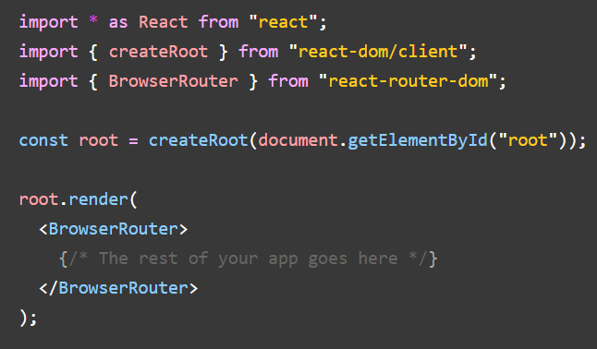
BROWSER ROUTER
A <BrowserRouter> stores the current location in the browser's address bar using clean URLs and navigates using the browser's built-in history stack.
App.js

Slide 59
ROUTING
Create React App doesn't include page routing.
React Router is the most popular solution.
Router allows the react application to include pagination

Slide 61
SPRING BOOT
Terminal
Spring Boot is a powerful framework designed to simplify the development of Java-based applications. It provides a comprehensive infrastructure for creating stand-alone, production-grade Spring applications with minimal configuration.

Slide 62
MODEL-VIEW-CONTROLLER (MVC)
Model: Represents the application's data and business logic. It encapsulates the core functionality and communicates with the database or other data sources. In Spring Boot, models are typically Java classes annotated with @Entity to map to database tables, and repositories are used to perform CRUD operations.

Slide 63
MODEL-VIEW-CONTROLLER (MVC)
View: The presentation layer that displays the data provided by the model. Views in Spring Boot can be created using technologies like Thymeleaf, JSP, or other templating engines. The view receives data from the controller and renders it to the user.

Slide 64
ENTITY-REPOSITORY-CONTROLLER-SERVICE ARCHITECTURE
The Entity-Repository-Controller-Service architecture in Spring Boot is a structured design pattern that promotes separation of concerns and maintainability. Entities represent the data model and map to database tables using JPA annotations.
Repositories provide CRUD operations and data access methods, abstracting database interactions. Services contain the business logic, acting as intermediaries between controllers and repositories.
Controllers handle HTTP requests, interact with services to process data, and return responses to clients. This architecture ensures a clean, modular codebase, enhancing scalability and testability.

Slide 65
ENTITY
Spring Boot, entities are Java classes that represent the data model and map to database tables. They are the core of the application's domain model and typically include the following characteristics:
Annotations: Entities are annotated with @Entity to indicate that they are JPA (Java Persistence API) entities. Other common annotations include @Table to specify the table name, @Id for the primary key, and @Column for specifying column details.

Slide 66
ENTITY
Fields: The class fields correspond to the columns in the database table. These fields can be annotated with @Column to define properties like column name, length, and constraints. Fields can also have relationships with other entities, annotated with @OneToOne, @OneToMany, @ManyToOne, or @ManyToMany.
Constructors: Entities typically have a no-argument constructor, which is required by the JPA specification. They can also have other constructors for convenience.

Slide 67
ENTITY
Getters and Setters: For each field, entities usually have getter and setter methods to allow access and modification of the field values.
Relationships: Entities can have relationships with other entities, defined through annotations such as @OneToOne, @OneToMany, @ManyToOne, and @ManyToMany. These annotations specify the nature of the relationships and how they should be mapped in the database.

Slide 68
ENTITY
import javax.persistence.Entity;
import javax.persistence.Id;
import javax.persistence.GeneratedValue;
import javax.persistence.GenerationType;
import javax.persistence.Column;
@Entity
public class User {
@Id
@GeneratedValue(strategy = GenerationType.IDENTITY)
private Long id;
@Column(nullable = false, unique = true)
private String username;
@Column(nullable = false)
private String password;
// No-argument constructor
public User() {}
// Getters and Setters
public Long getId() {
return id;
}
public void setId(Long id) {
this.id = id;
}
public String getUsername() {
return username;
}
public void setUsername(String username) {
this.username = username;
}
public String getPassword() {
return password;
}
public void setPassword(String password) {
this.password = password;
}
}

Slide 69
ENTITY
Entities in a Spring Boot application are linked with a database through the use of JPA (Java Persistence API) and database drivers. Here's a detailed explanation of how this connection is established and maintained:

Slide 70
ENTITY
1. Database Drivers
Database drivers are libraries that enable Java applications to communicate with a specific database. These drivers implement the JDBC (Java Database Connectivity) API, which provides methods for connecting to a database, executing SQL queries, and retrieving results.
2. Configuring the Data Source
In a Spring Boot application, the data source configuration specifies the database connection details, including the URL, username, password, and driver class. This configuration can be done in the application.properties or application.yml file. For example, for a MySQL database:

Slide 71
ENTITY
3. Entity Classes
Entities are Java classes annotated with @Entity, representing tables in the database. Each entity corresponds to a table, and the fields in the entity correspond to columns in that table.
4. ORM (Object-Relational Mapping)
JPA, along with an ORM provider like Hibernate (which is the default in Spring Boot), manages the mapping between the entity classes and the database tables. Hibernate translates the object-oriented Java code into SQL queries and handles the persistence of objects.

Slide 72
ENTITY
5. Entity Manager
The EntityManager interface provides methods for interacting with the persistence context, including methods for querying and managing entities. Spring Data JPA simplifies this by providing repository interfaces that extend JpaRepository or CrudRepository, which include standard CRUD operations.
6. Transaction Management
Spring Boot manages database transactions using annotations like @Transactional. This ensures that a series of operations are executed within a transaction, maintaining data integrity.

Slide 73
MAPPING
Mapping in the context of Spring Boot and JPA (Java Persistence API) refers to the process of defining how Java objects (entities) correspond to database tables. It involves specifying the relationships between entities and how their fields (attributes) map to database columns. Here's a theoretical explanation of the key components and concepts involved in mapping:

Slide 74
MAPPING
Entity Mapping:
@Entity: This annotation is used to mark a class as an entity, indicating that it should be mapped to a table in the database.
@Table: This annotation specifies the name of the database table that the entity maps to. If not provided, the table name defaults to the class name.

Slide 75
MAPPING
Field Mapping:
@Id: This annotation marks a field as the primary key of the entity.
@GeneratedValue: This annotation is used to specify how the primary key should be generated (e.g., automatically by the database).
@Column: This annotation maps a field to a specific column in the database table. It can also specify column properties like name, length, nullable, and uniqueness.

Slide 76
MAPPING
Relationship Mapping:
@OneToOne: Defines a one-to-one relationship between two entities. It can be unidirectional or bidirectional.
@OneToMany: Defines a one-to-many relationship, where one entity is related to multiple instances of another entity. Typically used with a List or Set.
@ManyToOne: Defines a many-to-one relationship, where multiple instances of one entity are related to a single instance of another entity. This is the inverse of @OneToMany.
@ManyToMany: Defines a many-to-many relationship, where multiple instances of one entity are related to multiple instances of another entity. Usually requires a join table to manage the relationship.

Slide 77
MAPPING
Join Annotations:
@JoinColumn: Specifies the foreign key column in the relationship. Used in @OneToOne, @ManyToOne, and @OneToMany mappings.
@JoinTable: Specifies the join table for @ManyToMany relationships. It defines the join table name and the join columns.

Slide 78
ENTITY
@Entity
@Table(name = "addresses")
public class Address {
@Id
@GeneratedValue(strategy = GenerationType.IDENTITY)
private Long id;
@Column(nullable = false)
private String street;
@Column(nullable = false)
private String city;
@OneToOne(mappedBy = "address")
private User user;
// Getters and Setters
}
@Entity
@Table(name = "users")
public class User {
@Id
@GeneratedValue(strategy = GenerationType.IDENTITY)
private Long id;
@Column(nullable = false, unique = true)
private String username;
@OneToOne(cascade = CascadeType.ALL)
@JoinColumn(name = "address_id", referencedColumnName = "id")
private Address address;
// Getters and Setters
}

Slide 79
MAPPING
Benefits of Mapping:
Abstraction: Simplifies database interactions by allowing developers to work with Java objects instead of SQL.
Consistency: Ensures that the application's data model is consistent with the database schema.
Flexibility: Supports complex relationships and data structures.
Maintainability: Changes to the data model are reflected in the database schema, making the application easier to maintain.
By defining mappings, Spring Boot and JPA provide a powerful and flexible way to interact with databases, enabling developers to focus on business logic rather than database management.

Slide 80
REPOSITORY
Terminal
Repository is an interface that encapsulates the mechanism for storage, retrieval, and search behavior which emulates a collection of objects. It is a key part of the Spring Data JPA module that aims to significantly improve the implementation of data access layers by reducing the boilerplate code required for data access.

Slide 81
KEY FEATURES OF A REPOSITORY IN SPRING BOOT
Data Access Layer Abstraction: Repositories abstract the data access layer and simplify CRUD (Create, Read, Update, Delete) operations.
Spring Data JPA Integration: Repositories leverage Spring Data JPA, providing easy integration with JPA-based data stores. They handle most of the database interactions automatically.
Repository Interfaces: Spring Boot allows the creation of repository interfaces that extend specific base interfaces provided by Spring Data JPA, such as CrudRepository, JpaRepository, and PagingAndSortingRepository.

Slide 82
JPA REPOSITORY
The JpaRepository interface in Spring Data JPA is a powerful tool that extends the basic CRUD and pagination functionalities provided by CrudRepository and PagingAndSortingRepository. It offers additional methods specific to JPA, enhancing the capabilities for managing persistent data. Below is a detailed explanation of the JpaRepository interface, its functionalities, and how to use it effectively.

Slide 83
JPA REPOSITORY
JpaRepository in Spring Boot is a comprehensive interface that extends CrudRepository and PagingAndSortingRepository to provide advanced JPA functionalities, making it easier to interact with the database. By using JpaRepository, developers can avoid boilerplate code, focus on business logic, and leverage powerful JPA features for efficient data access and management.

Slide 84
KEY FEATURES OF JPAREPOSITORY
CRUD Operations: Provides methods to perform basic CRUD operations without the need to write any SQL queries.
Pagination and Sorting: Extends the PagingAndSortingRepository to offer out-of-the-box pagination and sorting capabilities.
Batch Operations: Methods for performing batch operations.
JPA-Specific Methods: Adds JPA-specific methods that support the persistence context, entity lifecycle, and other JPA-related features.

Slide 85
BASIC CRUD METHODS
JpaRepository provides all the methods from CrudRepository, such as:
save(S entity): Saves a given entity.
saveAll(Iterable<S> entities): Saves all given entities.
findById(ID id): Retrieves an entity by its id.
existsById(ID id): Checks if an entity exists by its id.
findAll(): Returns all instances of the type.
findAllById(Iterable<ID> ids): Returns all instances with the given ids.
count(): Returns the number of entities.
deleteById(ID id): Deletes the entity with the given id.
delete(T entity): Deletes a given entity.
deleteAll(Iterable<? extends T> entities): Deletes the given entities.
deleteAll(): Deletes all entities.

Slide 86
ENTITY
@Entity
public class User {
@Id
@GeneratedValue(strategy = GenerationType.IDENTITY)
private Long id;
private String firstName;
private String lastName;
private String email;
private int age;
// Getters and setters
}

Slide 87
REPOSITORY INTERFACE
public interface UserRepository extends JpaRepository<User, Long> {
List<User> findByLastName(String lastName);
User findByEmail(String email);
List<User> findByAgeGreaterThan(int age);
}

Slide 88
SPRING SECURITY
Spring Security is a comprehensive security framework that provides authentication, authorization, and protection against common attacks. It is highly customizable and can be integrated with various authentication methods.

Slide 89
KEY FEATURES OF SPRING SECURITY
Authentication: Verifying the identity of users. It supports multiple authentication mechanisms like in-memory, LDAP, OAuth, and more.
Authorization: Deciding whether a user has permission to perform an action. This is managed using roles and authorities.
Protection against common attacks: Such as CSRF, XSS, and session fixation.

Slide 90
BASIC SETUP OF SPRING SECURITY
<dependency
<groupId>org.springframework.boot</groupId>
<artifactId>spring-boot-starter-security</artifactId>
</dependency>

Slide 91
BASIC SETUP OF SPRING SECURITY
Class Annotation: The class is annotated with @Configuration and @EnableWebSecurity, which designate it as a configuration class for Spring Security.
HttpSecurity Configuration: The configure(HttpSecurity http) method sets up security rules, allowing unrestricted access to URLs matching /public/**, requiring authentication for other requests, and enabling form-based login and logout functionalities.
Authentication Configuration: The configure(AuthenticationManagerBuilder auth) method configures in-memory authentication with two users, "user" with role "USER" and "admin" with role "ADMIN", using {noop} to indicate that passwords are stored in plain text.
@Configuration
@EnableWebSecurity
public class SecurityConfig extends WebSecurityConfigurerAdapter {
@Override
protected void configure(HttpSecurity http) throws Exception {
http
.authorizeRequests()
.antMatchers("/public/**").permitAll()
.anyRequest().authenticated()
.and()
.formLogin().loginPage("/login").permitAll()
.and()
.logout().permitAll();
}
@Override
protected void configure(AuthenticationManagerBuilder auth) throws Exception {
auth.inMemoryAuthentication()
.withUser("user").password("{noop}password").roles("USER")
.and()
.withUser("admin").password("{noop}admin").roles("ADMIN");
}
}

Slide 92
JWT AUTHENTICATION AND AUTHORIZATION
JWT (JSON Web Token) is a compact, URL-safe means of representing claims to be transferred between two parties. In the context of web security, it is often used for securing APIs.
Key Features:
Stateless: No need to store session information on the server, making it ideal for RESTful APIs.
Self-contained: Contains all the information needed for authentication.
Secure: Can be signed and optionally encrypted.

Slide 93
AUTHENTICATION
Authentication is the process of verifying the identity of a user or system. It ensures that only legitimate users can access the application.
User Identification: Confirms that the person accessing the application is who they claim to be, typically through credentials like usernames and passwords.
Personalized Experience: Enables the application to provide a personalized user experience based on the authenticated user's identity and preferences.
Security: Prevents unauthorized access to the system, reducing the risk of data breaches and unauthorized actions.

Slide 94
AUTHORIZATION
Authorization determines what an authenticated user is allowed to do. It defines access controls and permissions within the application.
Access Control: Ensures that users can only access resources and perform actions that they have been granted permission for, protecting sensitive data and functionalities.
Data Protection: Restricts access to confidential or sensitive information, ensuring that only authorized users can view or modify it.
Resource Management: Manages the availability and utilization of application resources, preventing misuse or overuse by unauthorized users.

Slide 95
BENEFITS OF AUTHENTICATION AND AUTHORIZATION
Enhanced Security: Protects the application from unauthorized access and potential attacks by ensuring only legitimate users can access the system and perform specific actions.
Data Integrity: Safeguards the integrity of the data by restricting who can view or modify information, reducing the risk of accidental or malicious changes.
Regulatory Compliance: Helps in complying with industry regulations and standards that require strict access control and data protection mechanisms.
Audit and Accountability: Provides a trail of user activities, allowing for monitoring and auditing actions taken within the application, which is crucial for identifying and addressing security incidents.
User Management: Facilitates efficient user management by assigning roles and permissions, making it easier to control and monitor user access within the application.

Slide 96
EXAMPLE SCENARIO
Consider a banking web application:
Authentication ensures that only valid customers can log into their accounts using their credentials.
Authorization ensures that once authenticated, customers can only access their own account details and perform specific actions (like viewing account balance, transferring funds) according to their permissions, while bank staff may have broader access to perform administrative tasks.
By implementing robust authentication and authorization mechanisms, the banking application can protect sensitive financial data, provide personalized and secure user experiences, and comply with regulatory requirements.

Slide 97
ENCRYPTION
Encryption is the process of converting plaintext data into a coded form, called ciphertext, to prevent unauthorized access. Only those with the correct decryption key can convert the ciphertext back into plaintext.
Key Features:
Data Protection: Ensures that data is unreadable to unauthorized users.
Data Integrity: Protects data from being altered by unauthorized users.
Confidentiality: Ensures that sensitive data is only accessible to those with the correct decryption key.

Slide 98
ENCRYPTION
Types of Encryption:
Symmetric Encryption: The same key is used for both encryption and decryption. Examples include AES (Advanced Encryption Standard) and DES (Data Encryption Standard).
Asymmetric Encryption: Uses a pair of keys, one for encryption (public key) and one for decryption (private key). Examples include RSA (Rivest-Shamir-Adleman).

Slide 99
TOKENIZATION
Tokenization is the process of replacing sensitive data with a non-sensitive placeholder, called a token. The actual data is stored securely in a tokenization system, and only the token is used in the application.
Key Features:
Data Security: Reduces the risk of exposing sensitive data by using tokens.
Regulatory Compliance: Helps meet compliance requirements for protecting sensitive information.
Scope Limitation: Tokens are limited in scope and cannot be used outside their intended context, reducing the risk of data breaches.
Example:
Credit Card Tokenization: Replacing a credit card number with a token that can be used within the application but has no meaning outside it.

Slide 100
COMPARISON AND USE CASES
Encryption:
Use Cases: Protecting data in transit (e.g., HTTPS, VPN), securing data at rest (e.g., encrypted databases), protecting sensitive files.
Pros: Strong security, widely used and standardized.
Cons: Requires key management, can be computationally intensive.

Slide 101
COMPARISON AND USE CASES
Tokenization:
Use Cases: Protecting payment card information, securing Personally Identifiable Information (PII), reducing the scope of regulatory compliance.
Pros: Reduces risk of data exposure, simplifies compliance, minimal impact on system performance.
Cons: Tokens are context-specific, requires a secure tokenization system.

Slide 102
API DISCOVERY
API discovery is a mechanism that enables services in a distributed system to find and communicate with each other without relying on hardcoded addresses. In a microservices architecture, where services often scale up and down dynamically, it’s crucial to have a system that tracks the availability and addresses of these services. API discovery ensures that services can discover the location of other services, enabling seamless inter-service communication.

Slide 103
KEY COMPONENTS OF API DISCOVERY
Service Registry: A centralized database that stores the network locations of service instances.
Service Discovery: The process through which services register their existence and other services query the registry to find these services.
Load Balancing: Distributes network or application traffic across multiple servers to ensure no single server bears too much demand.

Slide 104
EUREKA
Eureka is a service registry that is part of the Netflix OSS stack, which is now widely used in microservices architectures. It is primarily designed to handle the dynamic nature of microservices, where services need to find and communicate with each other efficiently.

Slide 105
FEATURES OF EUREKA
Service Registration and Discovery: Services register themselves with the Eureka server, providing details like host and port, health indicators, and other metadata.
Client-Side Load Balancing: Eureka clients use the information in the registry to balance the load across multiple service instances.
Self-Preservation Mode: Ensures that the registry does not unnecessarily remove instances during a network partition or when some instances are temporarily unreachable.
Health Checks: Clients can periodically send heartbeats to the server to indicate they are still alive.

Slide 106
HOW EUREKA WORKS
Eureka Server: Acts as a service registry where all client applications (services) register themselves.
Eureka Clients: The services that register with Eureka. They use the information in Eureka to discover other services.
Discovery: When a client needs to communicate with another service, it queries the Eureka server to get a list of all available instances of that service and connects to one.

Slide 107
STEPS TO IMPLEMENT EUREKA INTO AN EXISTING SOLUTION
Set Up the Eureka Server
Add Dependencies: In your Maven or Gradle project, add the spring-cloud-starter-netflix-eureka-server dependency.
<dependency>
<groupId>org.springframework.cloud</groupId>
<artifactId>spring-cloud-starter-netflix-eureka-server</artifactId>
</dependency>

Slide 108
STEPS TO IMPLEMENT EUREKA INTO AN EXISTING SOLUTION
Create a Spring Boot Application: Annotate the main class with @EnableEurekaServer and run the application.
@SpringBootApplication
@EnableEurekaServer
public class EurekaserverappApplication {
public static void main(String[] args) {
SpringApplication.run(EurekaserverappApplication.class, args);
}
}

Slide 109
STEPS TO IMPLEMENT EUREKA INTO AN EXISTING SOLUTION
Configure Application Properties: Define the application name and port, and disable self-registration.
spring.application.name=eureka-server
server.port=8761
eureka.client.register-with-eureka=false
eureka.client.fetch-registry=false

Slide 110
CONFIGURE EUREKA CLIENTS
Add Dependencies: For each service that you want to register with Eureka, add the spring-cloud-starter-netflix-eureka-client dependency.
<dependency>
<groupId>org.springframework.cloud</groupId>
<artifactId>spring-cloud-starter-netflix-eureka-client</artifactId>
</dependency>

Slide 111
CONFIGURE EUREKA CLIENTS
Enable Eureka Client: Annotate the main class of each service with @EnableEurekaClient.
@SpringBootApplication
@EnableEurekaClient
public class MyServiceApplication {
public static void main(String[] args) {
SpringApplication.run(MyServiceApplication.class, args);
}
}

Slide 112
CONFIGURE EUREKA CLIENTS
Configure Application Properties: Set up the application to register with the Eureka server.
spring.application.name=my-service
eureka.client.serviceUrl.defaultZone=http://localhost:8761/eureka/

Slide 113
SERVICE DISCOVERY AND COMMUNICATION
Discovering Services: Use the DiscoveryClient interface provided by Spring Cloud to discover other services registered with Eureka.
Load Balancing: Spring Cloud automatically provides client-side load balancing via Ribbon when using RestTemplate or Feign.
@Autowired
private DiscoveryClient discoveryClient;
public List<ServiceInstance> getInstances(String serviceName) {
return discoveryClient.getInstances(serviceName);
}

Slide 114
TESTING AND DEPLOYMENT
Run Eureka Server: Start the Eureka server and check if it's running on http://localhost:8761.
Register Clients: Start your services, and they should automatically register with the Eureka server.
Monitor the Registry: Use the Eureka dashboard at http://localhost:8761 to monitor registered services.

Slide 115
OPTIONAL: CONFIGURING HIGH AVAILABILITY
Cluster Eureka Servers: Set up multiple Eureka servers for redundancy. Configure each server to replicate its registry with the others.
eureka.client.serviceUrl.defaultZone=http://eureka-peer1:8761/eureka/,http://eureka-peer2:8761/eureka/
By following these steps, you can successfully integrate Eureka into your microservices architecture, enabling dynamic service discovery and improved resiliency in your application.

